Slide 1
Google Play Store: App Permission Analytics
Prajit Kumar Das
Advised by: Dr. Anupam Joshi

Slide 2
Data collection stats
According to AppBrain
Current number of Android apps in the market: 1,596,584
54 App categories including Medical and Health & Fitness
46874 Health & Fitness Apps and 23824 Medical Apps
App data collected
Total app data collected: 1,431,736
42958 Health & Fitness Apps and 21033 Medical Apps
Does not reflect app permission info
Total number of apps whose permissions have been collected: 106,979
2620 Health & Fitness Apps and 758 Medical Apps

Slide 3
A bit more stats
Medical Apps request
262 unique permissions, top 20 requested permissions are shown below
Number of apps requesting permission | Permission Name
715 | android.permission.INTERNET
596 | android.permission.ACCESS_NETWORK_STATE
448 | android.permission.READ_EXTERNAL_STORAGE
447 | android.permission.WRITE_EXTERNAL_STORAGE
245 | android.permission.READ_PHONE_STATE
218 | android.permission.WAKE_LOCK
196 | android.permission.VIBRATE
151 | android.permission.GET_ACCOUNTS
145 | android.permission.ACCESS_FINE_LOCATION
143 | android.permission.ACCESS_COARSE_LOCATION
139 | com.google.android.c2dm.permission.RECEIVE
125 | android.permission.ACCESS_WIFI_STATE
91 | com.android.vending.BILLING
85 | android.permission.RECEIVE_BOOT_COMPLETED
80 | android.permission.CAMERA
67 | android.permission.CALL_PHONE
41 | android.permission.READ_CONTACTS
41 | com.google.android.providers.gsf.permission.READ_GSERVICES
41 | com.android.vending.CHECK_LICENSE
34 | android.permission.RECORD_AUDIO

Slide 4
A bit more stats
Health and Fitness Apps request
733 unique permissions, top 20 requested permissions are shown below
Number of apps requesting permission | Permission Name
2501 | android.permission.INTERNET
2204 | android.permission.ACCESS_NETWORK_STATE
1413 | android.permission.WRITE_EXTERNAL_STORAGE
1404 | android.permission.READ_EXTERNAL_STORAGE
816 | android.permission.WAKE_LOCK
715 | android.permission.READ_PHONE_STATE
618 | android.permission.VIBRATE
577 | android.permission.ACCESS_WIFI_STATE
575 | android.permission.ACCESS_FINE_LOCATION
516 | android.permission.ACCESS_COARSE_LOCATION
498 | android.permission.GET_ACCOUNTS
445 | com.google.android.c2dm.permission.RECEIVE
362 | android.permission.RECEIVE_BOOT_COMPLETED
322 | com.android.vending.BILLING
285 | android.permission.CAMERA
173 | android.permission.RECORD_AUDIO
150 | com.android.vending.CHECK_LICENSE
140 | android.permission.GET_TASKS
139 | com.google.android.providers.gsf.permission.READ_GSERVICES
122 | android.permission.SYSTEM_ALERT_WINDOW

Slide 5
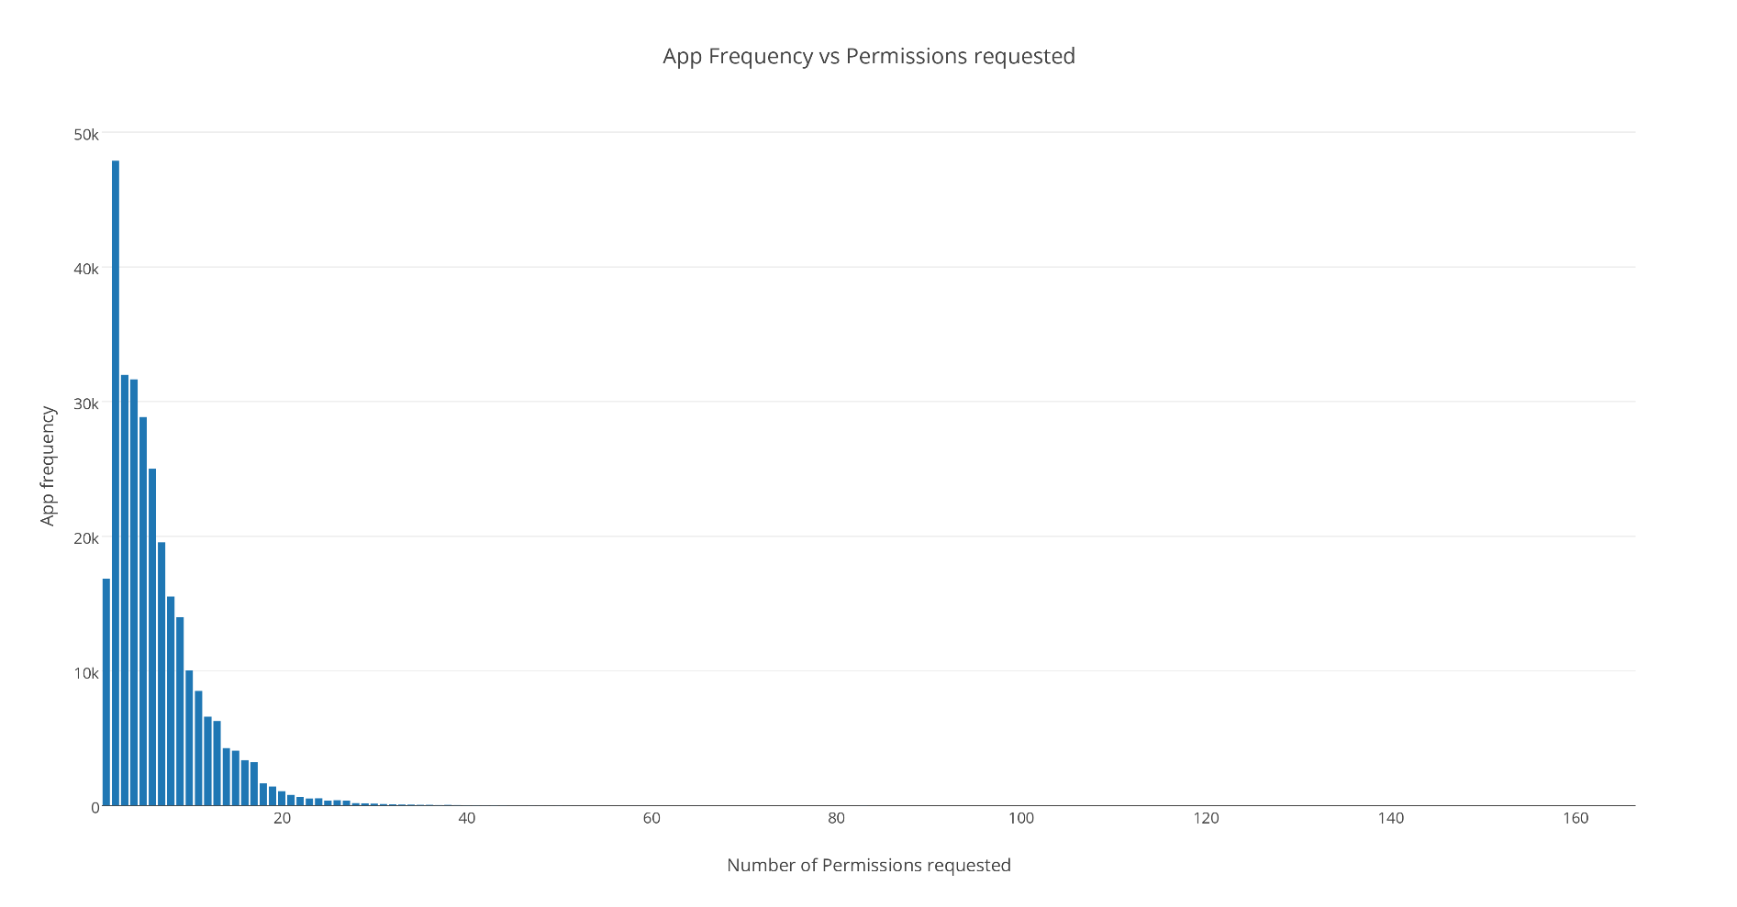
App frequency vs Permissions requested
App Package Name | Permissions Count
com.google.android.gms | 102
com.grabtaxi.system | 84
com.customermobile.att.samsung.gs4 | 83
com.tencent.mtt | 82
com.qihoo360.mobilesafe | 81
com.comfinix.android.barotalk | 81
com.nineninetaxis.driver | 77
com.google.android.googlequicksearchbox | 75
com.airwatch.androidagent | 71
com.qihoo360.launcher | 69
com.vodafone.androidagent | 69
App Count | Permission Name
100863 | android.permission.INTERNET
90819 | android.permission.ACCESS_NETWORK_STATE
64766 | android.permission.READ_EXTERNAL_STORAGE
64703 | android.permission.WRITE_EXTERNAL_STORAGE
39355 | android.permission.READ_PHONE_STATE
34173 | android.permission.ACCESS_WIFI_STATE
33256 | android.permission.WAKE_LOCK
24500 | android.permission.VIBRATE
17503 | android.permission.ACCESS_COARSE_LOCATION
17030 | android.permission.ACCESS_FINE_LOCATION
17003 | android.permission.GET_ACCOUNTS

Slide 6
Algorithm working on
Transform an app to a vector rep by denoting which permission it is requesting
Technique 1: Use vector as an input to k-means clustering – Does app category become evident?
Technique 2: Select a category and using app permission vector try to detect outlier apps
Technique 3:
For apps requesting a bunch of unique permissions, extract app description
Can semantic similarity help in matching descriptions to permissions

Slide 7
Cluster evaluation
Homogeneity Score: A clustering result satisfies homogeneity if all of its clusters contain only data points which are members of a single class.
Completeness Score: A clustering result satisfies completeness if all the data points that are members of a given class are elements of the same cluster.

Slide 8
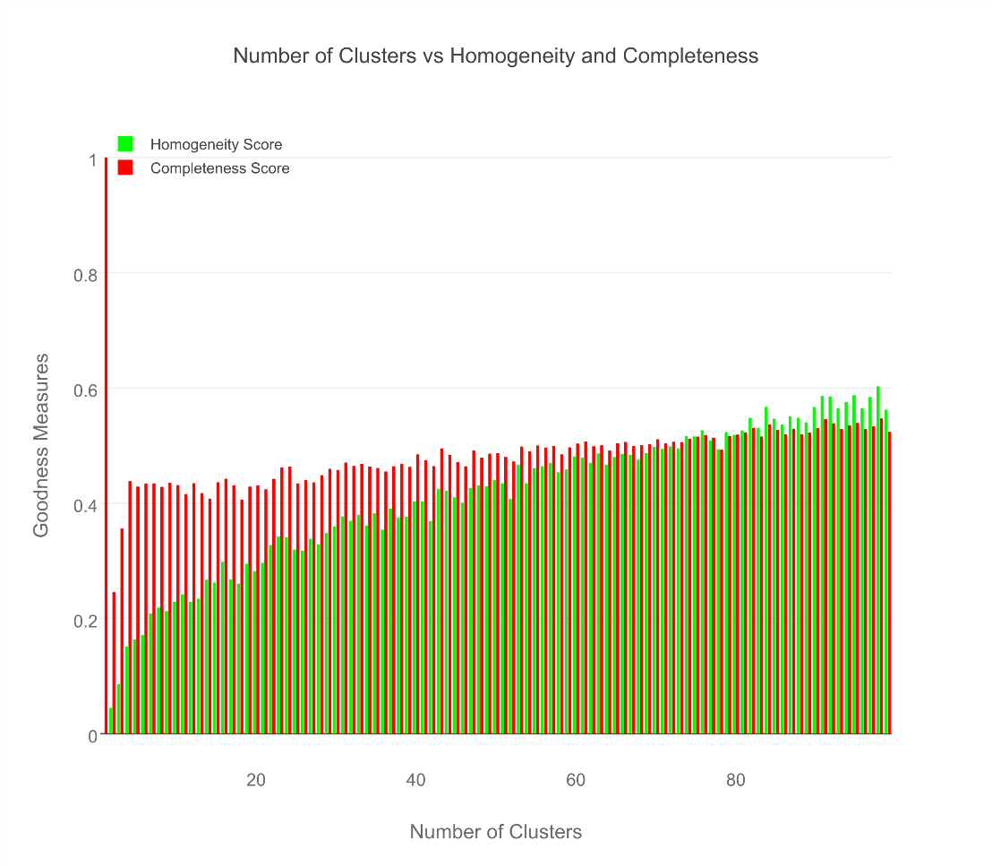
Cluster evaluation

Slide 9
The best result for Med-Health Apps
AppPkgName | AppCategory
com.fitnow.loseit | Health & Fitness
com.webmd.android | Health & Fitness
com.drugscom.app | Medical
com.ovuline.pregnancy | Medical
air.com.peppapig.paintbox | Educational
com.t11.skyviewfree | Education
gov.nasa | Education
com.google.android.stardroid | Books & Reference
com.turner.cnvideoapp | Media & Video
com.nextradioapp.nextradio | Music & Audio
com.camerasideas.instashot | Photography
com.foxsports.videogo | Sports
com.theopen | Sports
com.tregware.radar | Weather

